Slide 1
This is the Teal Title Slide, you can swap to the Blue 1 Title Slide or Blue2 Title Slide in the Layout menu
Notes:
Overview of the terminology behind the main identifier.

Slide 2
Layout: Aqua footer sm
Swap to other slide layouts in the Layout menu

Slide 3



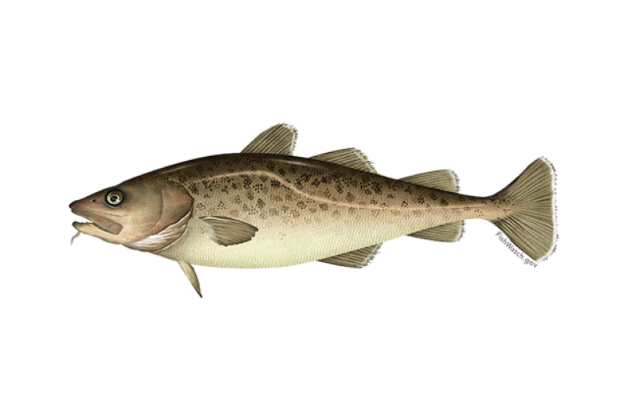
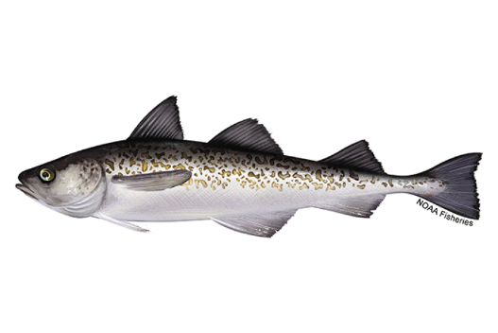

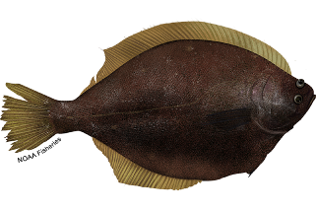
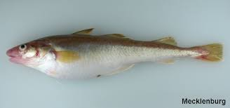
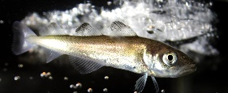
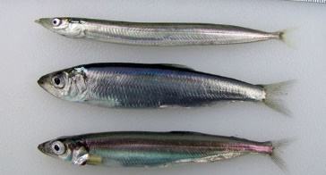
Non-focal relationship
Focal relationship
+
+
-
-
+
+
+
+
+
+
Notes:
Interpretation of above from abundance index results 4/6/23:
Consistent with conceptual model:
-arctic cod and saffron cod (on longer timescale) decreasing with less sea ice
-yellowfin sole, Pollock and Pcod increasing with less sea ice (and declining in last few years with increasing sea ice)
-herring increasing (in warmer years)
-bivalves increasing since 2010
Inconsistent with conceptual model:
-snow crab declining with presumably increased forage (perhaps confounded by temperature effects, disease, predation, cannibalism)

Slide 4
Layout: Navy footer 1
Swap to other slide layouts in the Layout menu
Notes:
Previous identity has proved to be overly complex to apply, reducing buy-in. The old brand guide did not perform well in the difficult balancing act between consistency and sameness.
This presentation introduces branding goals and outlines proposed changes to the brand standards guide.

Slide 5
Layout: Minimal Logo Swoosh
Swap to other slide layouts in the Layout menu
Notes:
Previous identity has proved to be overly complex to apply, reducing buy-in. The old brand guide did not perform well in the difficult balancing act between consistency and sameness.

Slide 6
Layout: Minimal Swoosh
Swap to other slide layouts in the Layout menu
Notes:
The NMFS Emblem is the key to a stronger brand.

